Slide 1


Department of Computer Science

Slide 2

SPM (Smart Parking Management)
Fall 2023
SeyedMohammadSadegh Jafari Sheshtamad
Mahdi Banisharifdehkordi

Slide 3
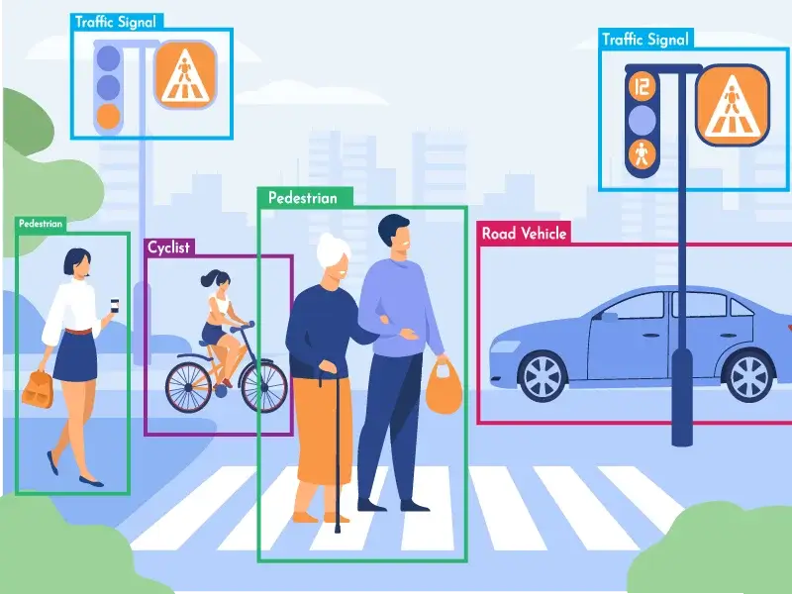
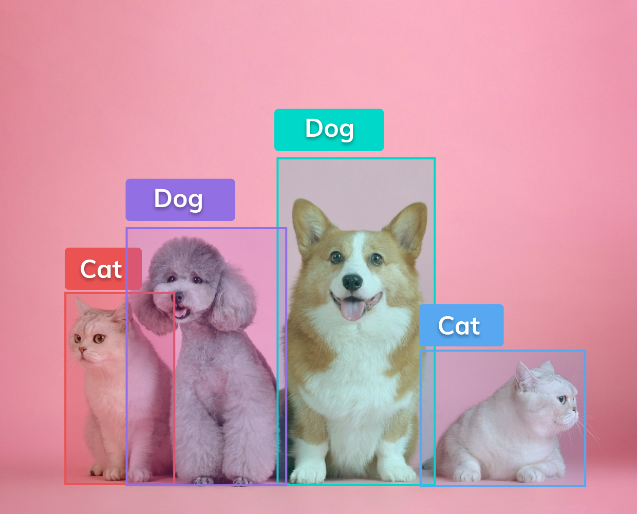
About Object Detection
Definition: Identifying and locating objects within images or videos.
Importance: Crucial for advancements in computer vision and AI.
From traditional image processing to deep learning.
Progression towards more accurate and faster models.

Slide 4
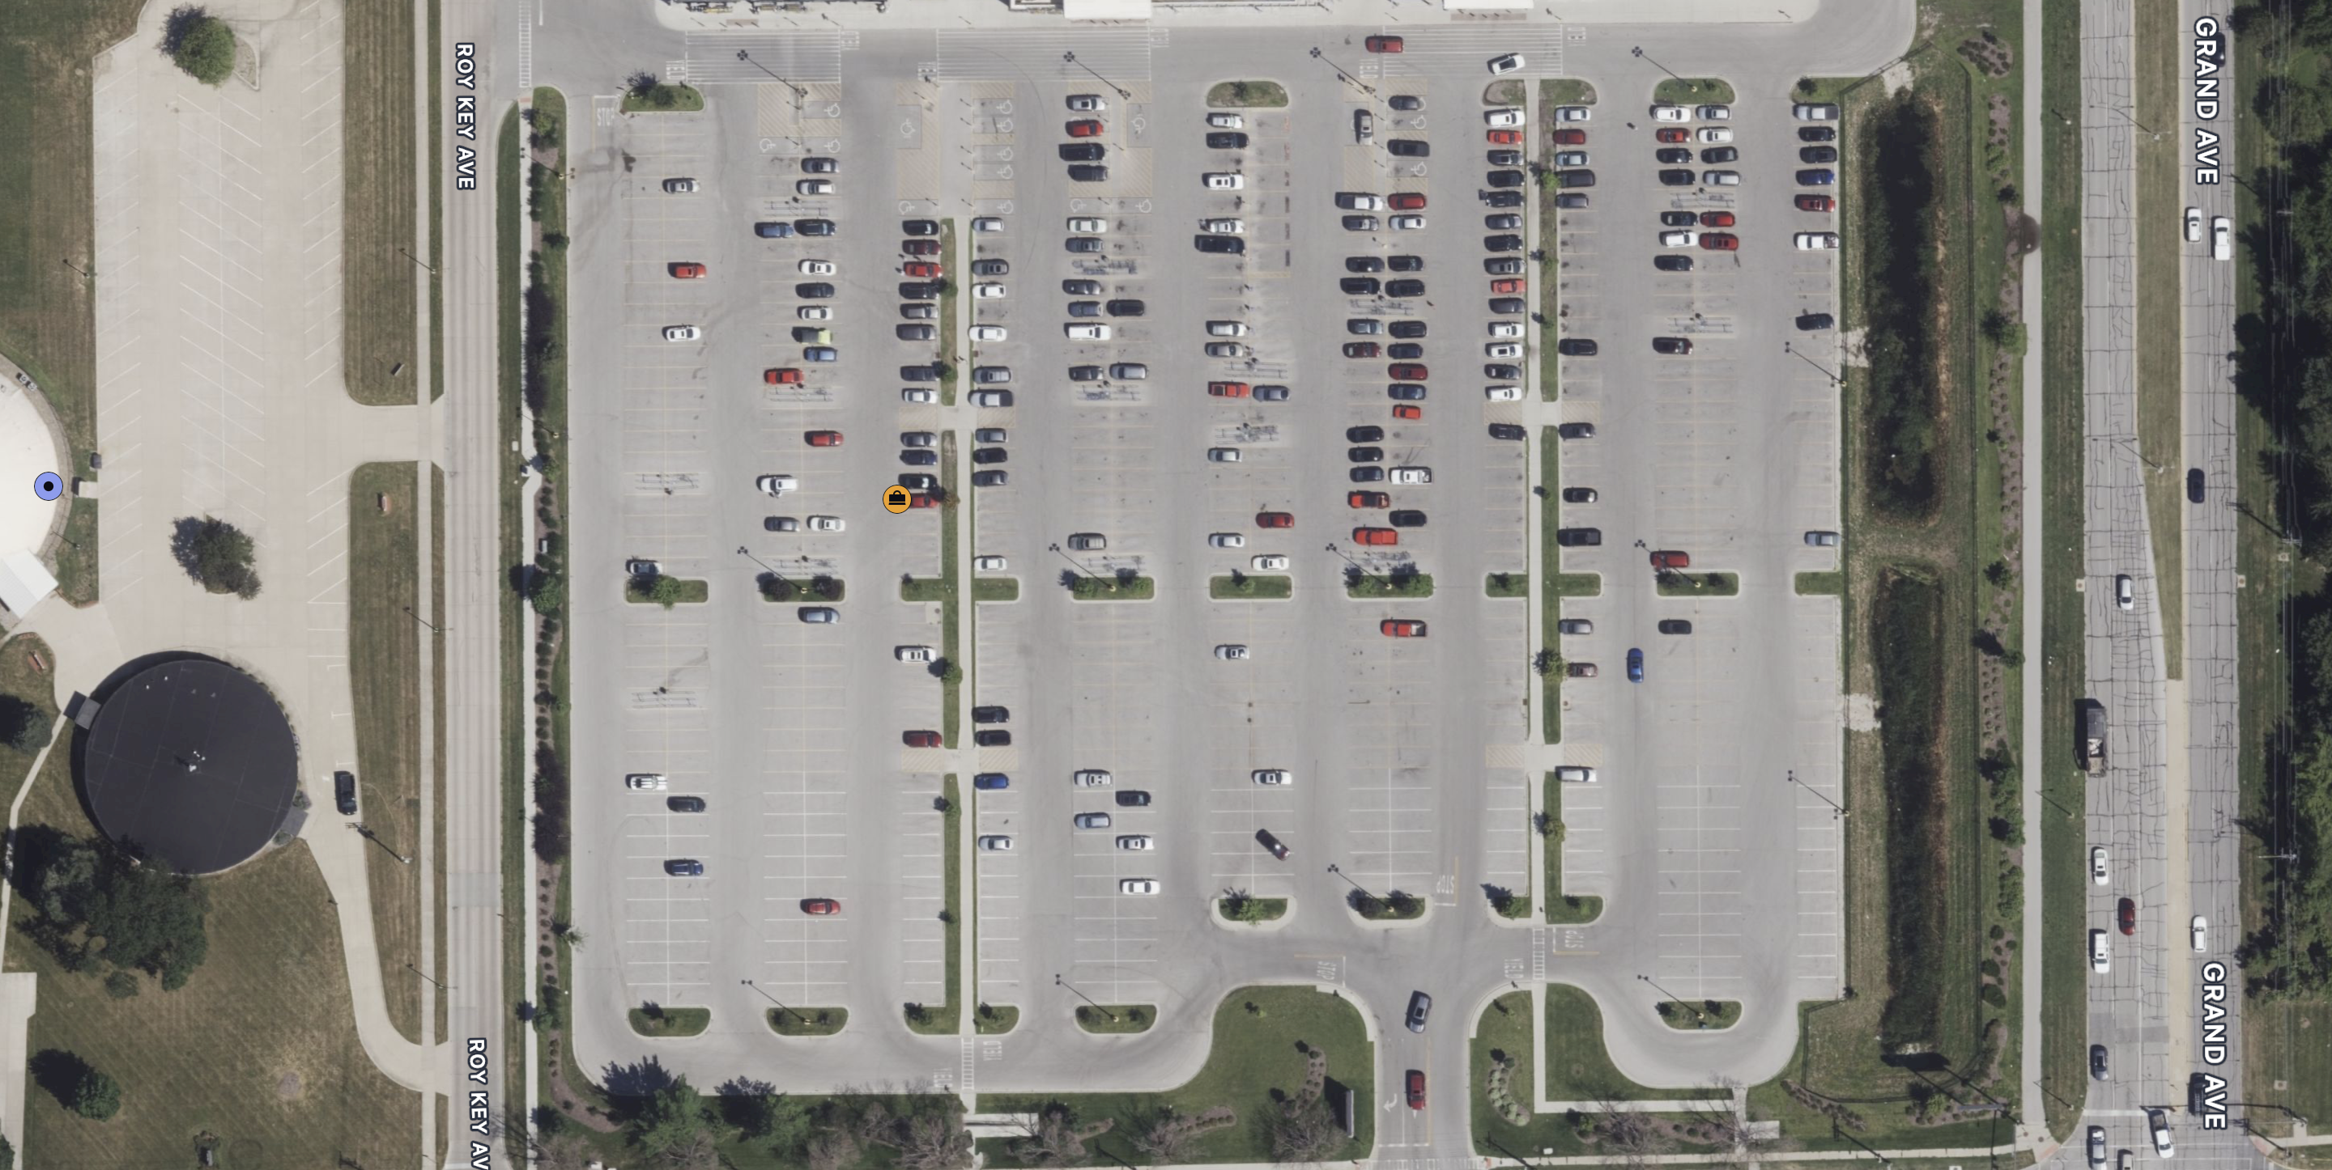
The Problem
Our study focuses on the analysis of parking areas in Ames
Finding parking is a frequent challenge
Develop a model that analyzes parking area images to count cars, identify available parking spots, and calculate the percentage of available parking spaces

Slide 5
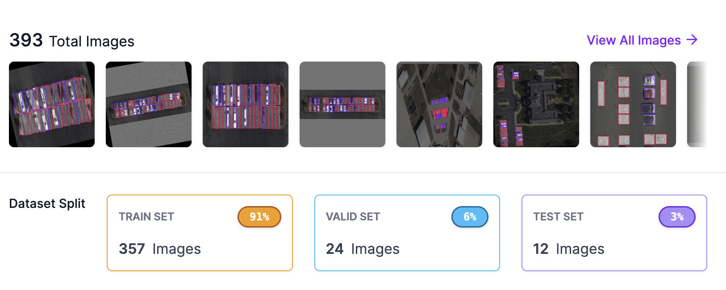
Parking Detection with Custom Dataset
Google Maps images
Two classes: Parked and Empty
Total number of Images: 393
Training : 357 / Validation: 24 / Test: 12

Slide 6
Augmentations
Rotation: Between -15° and +15°
Noise: Up to 15% of pixels
Bounding Box: Shear: ±34° Horizontal, ±26° Vertical
Bounding Box: Blur: Up to 2.5px

Slide 7
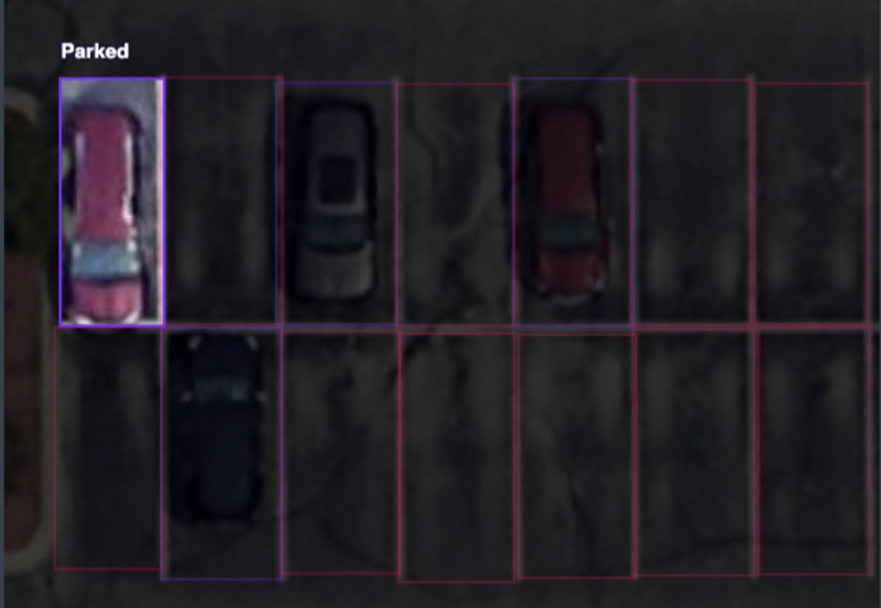
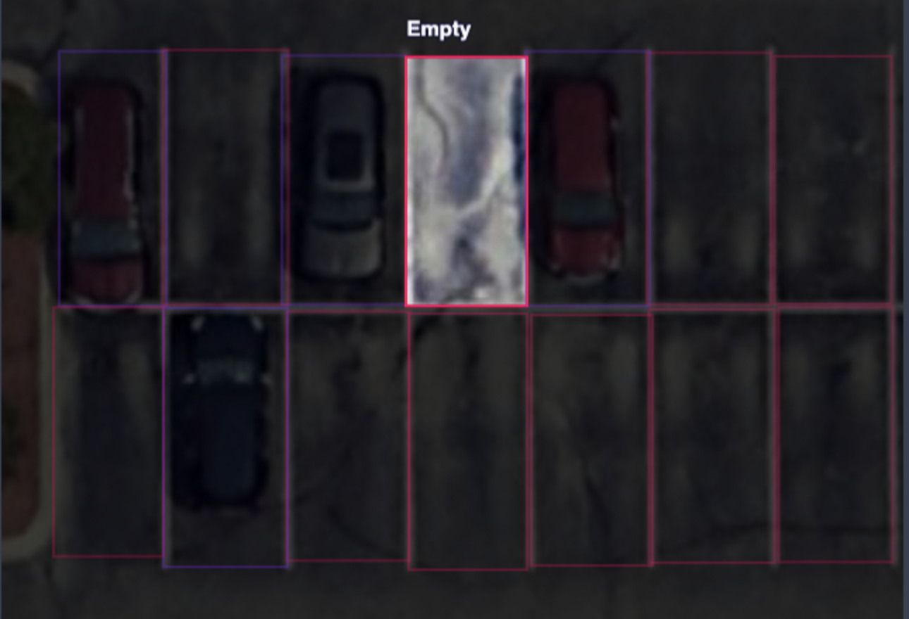
Parking Detection with Custom Dataset
Using Roboflow website for image annotation
Expected output: Identify and locate parked and empty spots in a given image or video.

Slide 8
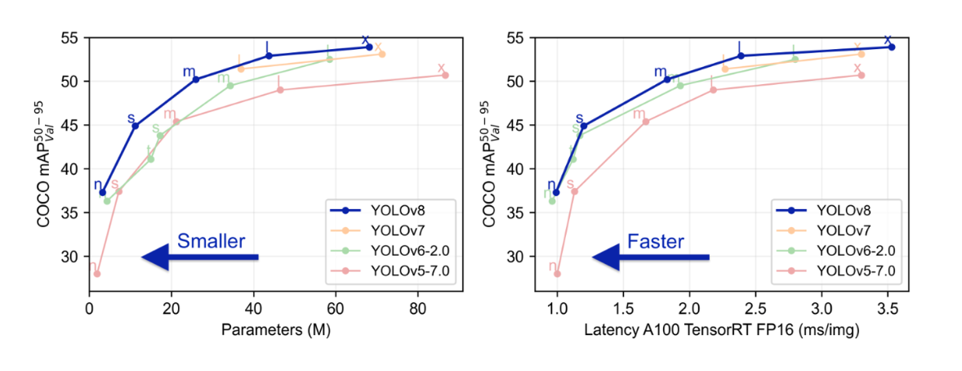
YOLO-Based Parking Detection
A state-of-the-art real-time object detection system.
Renowned for its speed and accuracy.
A distinct method: Analyzes the entire image in one pass.
“You Only Look Once” - a single neural network predicts bounding boxes and class probabilities.
We employed the YOLO v8 algorithm

Slide 9
Related work
Giuseppe Amato et al.: Developed a Convolutional Neural Network (CNN) system for real-time parking occupancy detection on smart cameras, effective under various conditions. Introduced CNRPark dataset for future research, highlighting CNN's robustness in vision-related problems.
Francesco Piccialli et al.: Discussed smart parking's role in reducing urban traffic and pollution. Proposed a deep learning ensemble technique for forecasting parking occupancy using IoT data, emphasizing artificial intelligence and IoT in traffic management.
Our Approach: Opted to create a custom dataset, focusing on specific data collection and annotation to align with project goals, ensuring data integrity and tailored application.

Slide 10
Experimental setups: Training
We conducted our training on Google Colab, a cloud-based platform that offers an interactive environment for machine learning and data analysis.
Google V-100 GPU – High-RAM
The model we used yolov8s.pt
epochs: 100
imgsz: 600
batch: 16
Learning Rate: lr0 0.01 /
168 layers
11126358 parameters / 11+ million
All classes mAP50 : 0.891

Slide 11
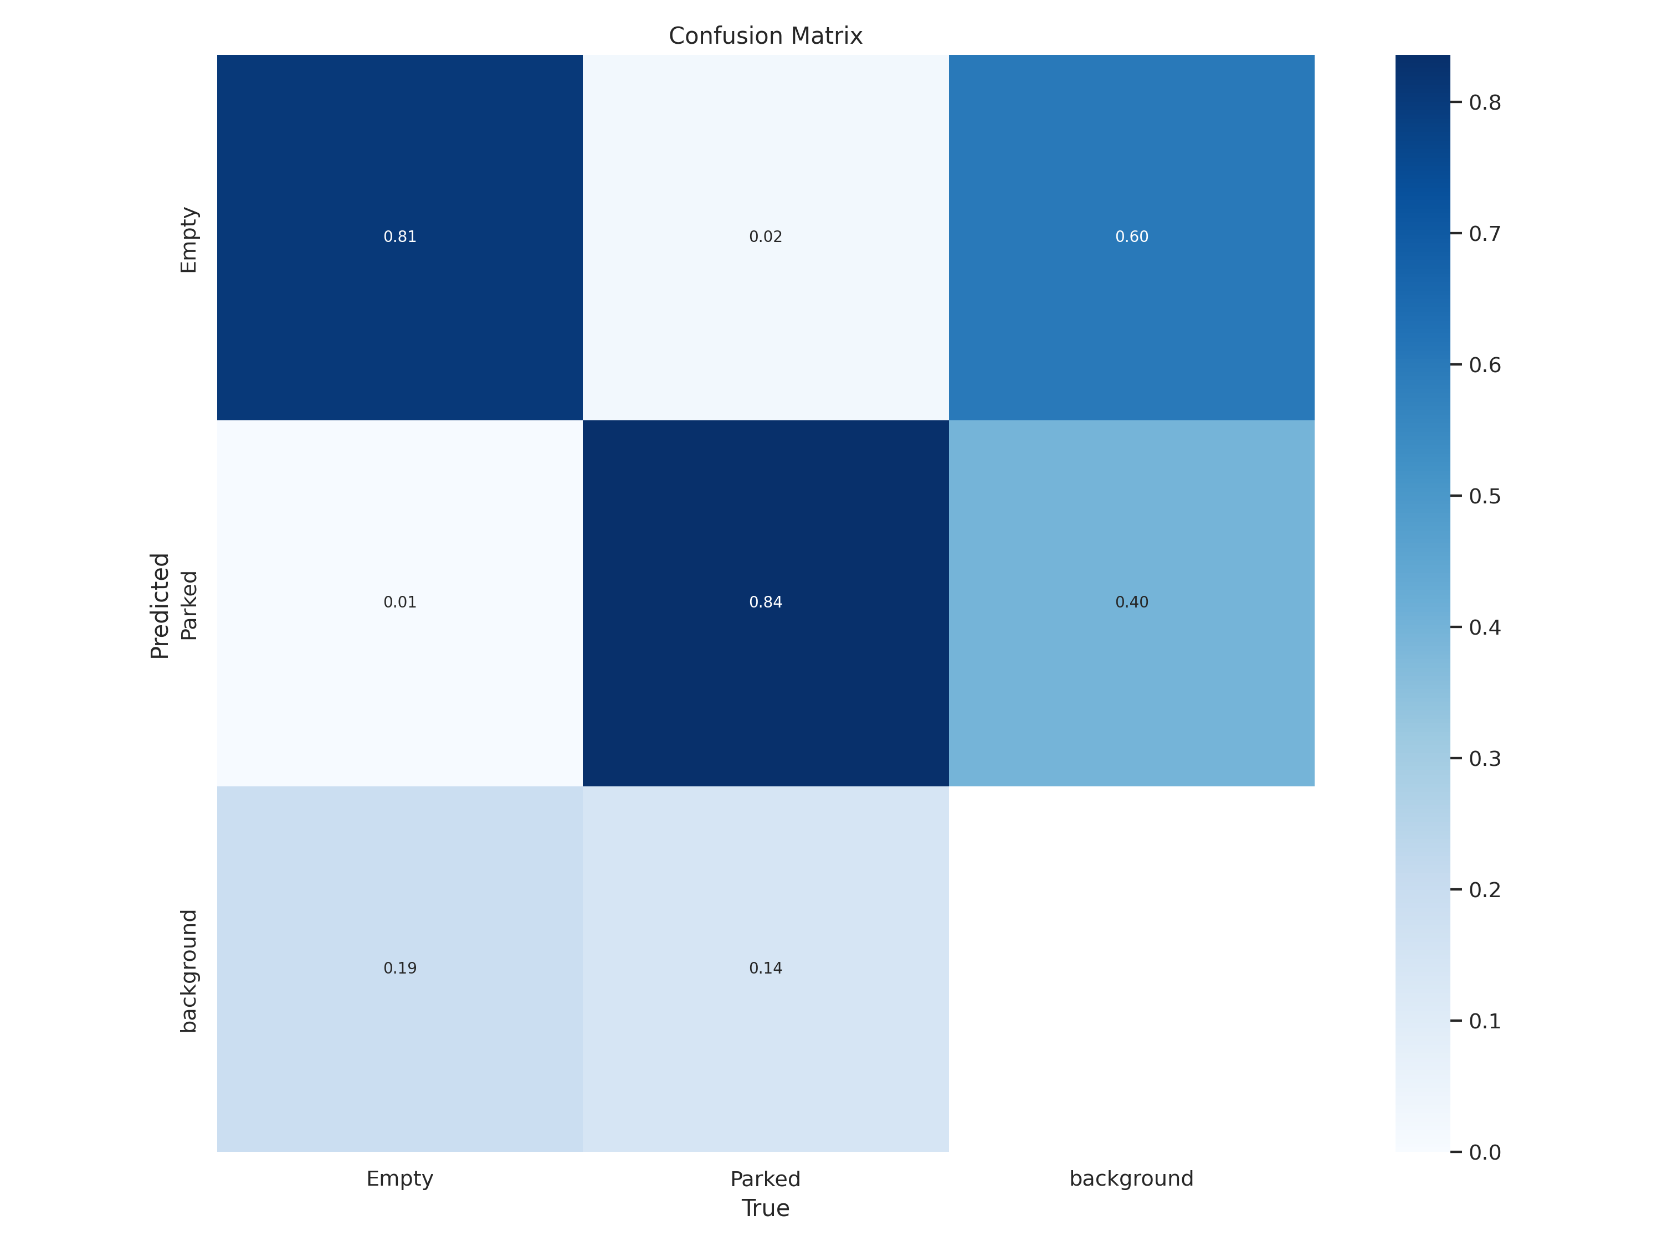
Experimental setups: Training

Slide 12
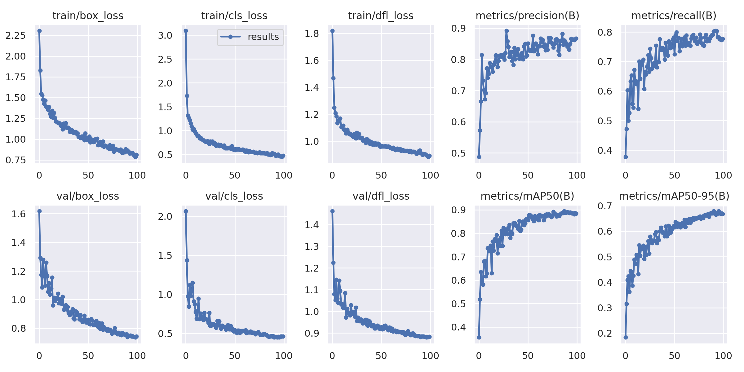
Experimental setups: Training

Slide 13
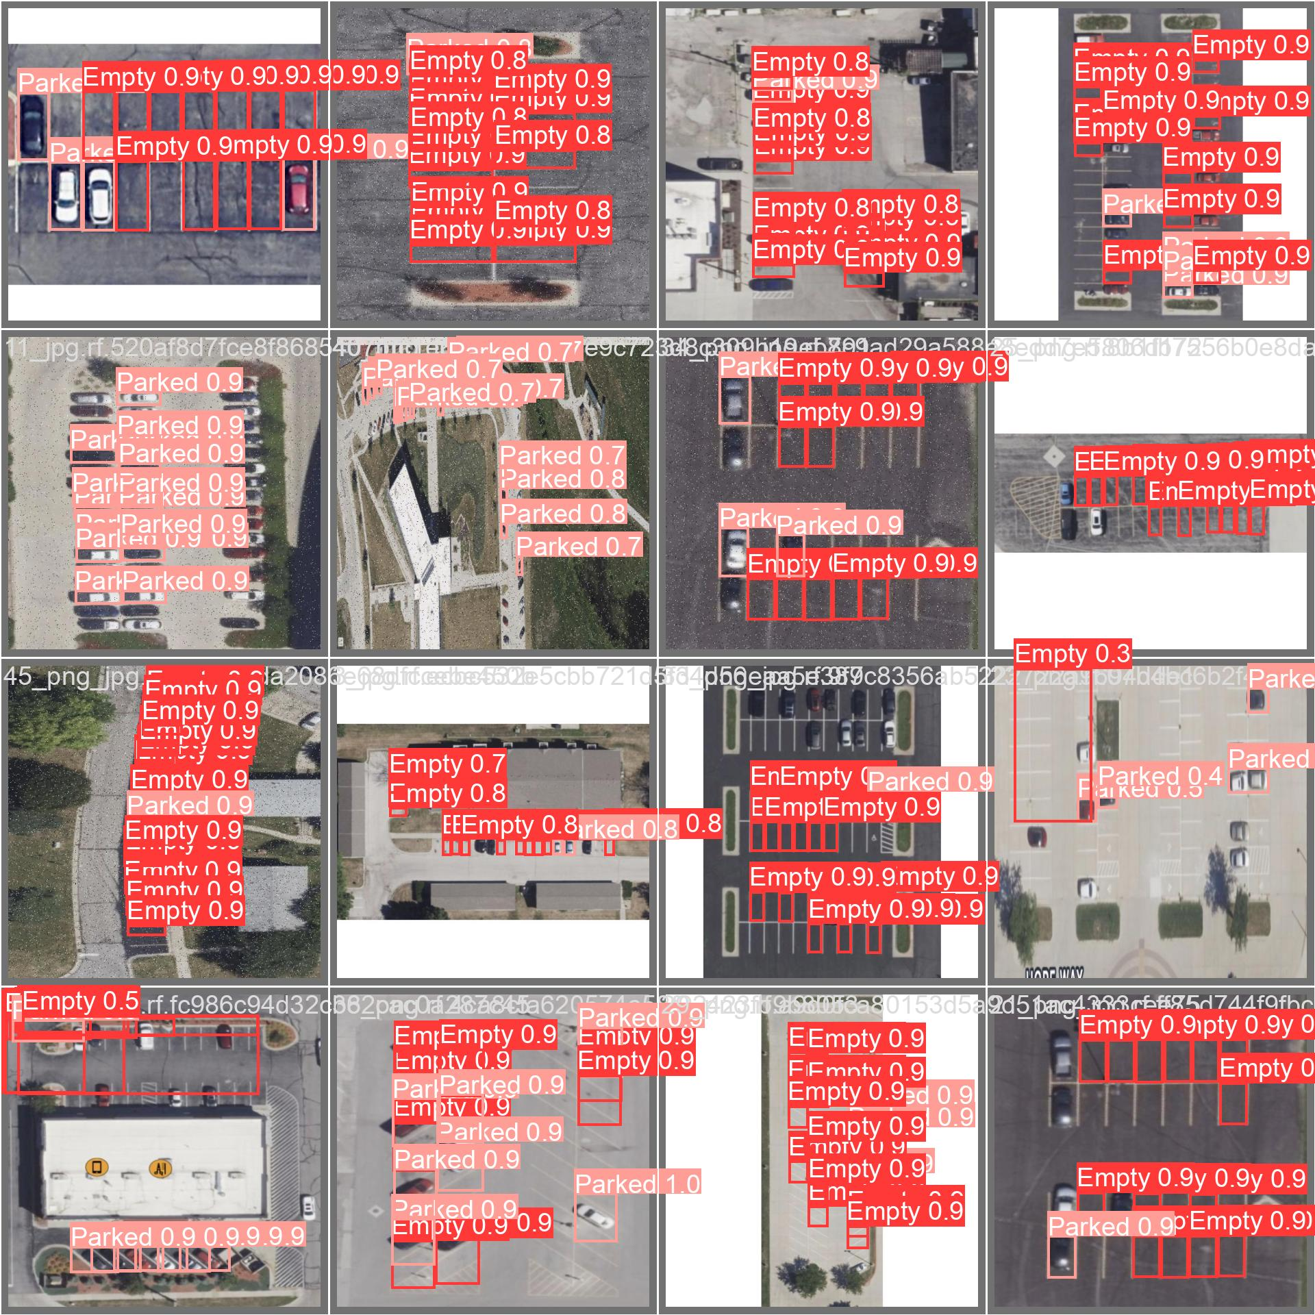
Experimental setups: Validation

Slide 14
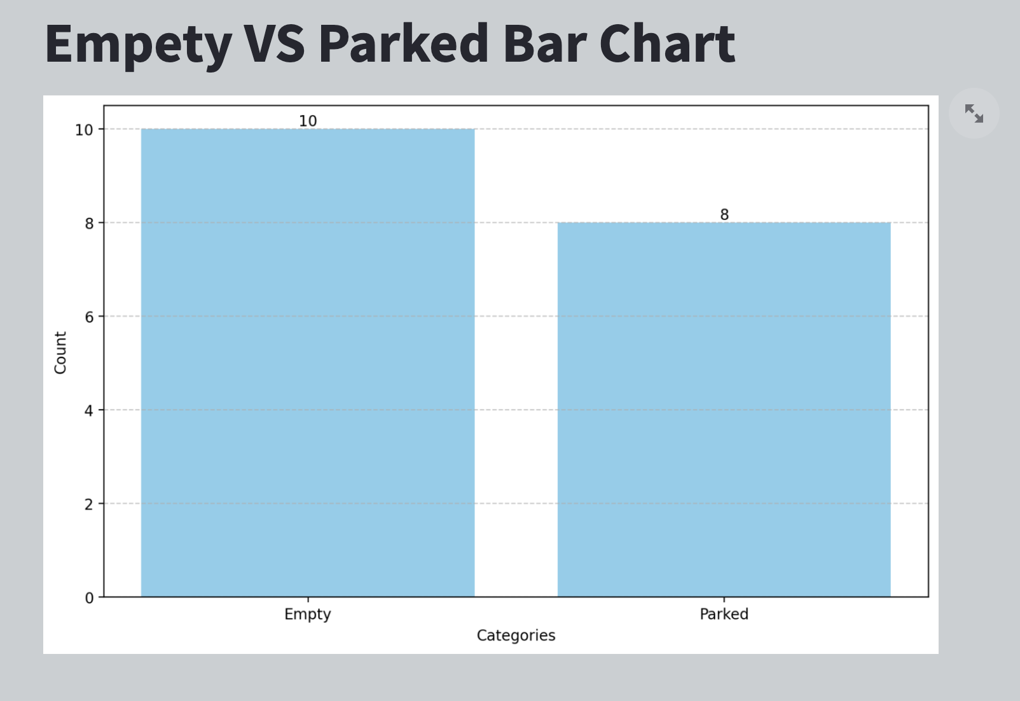
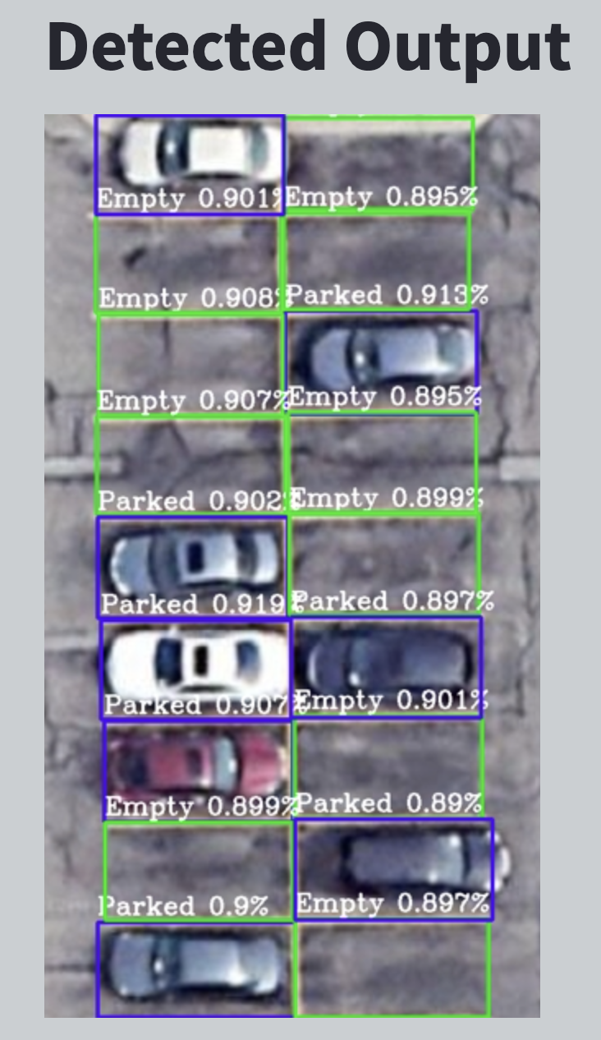
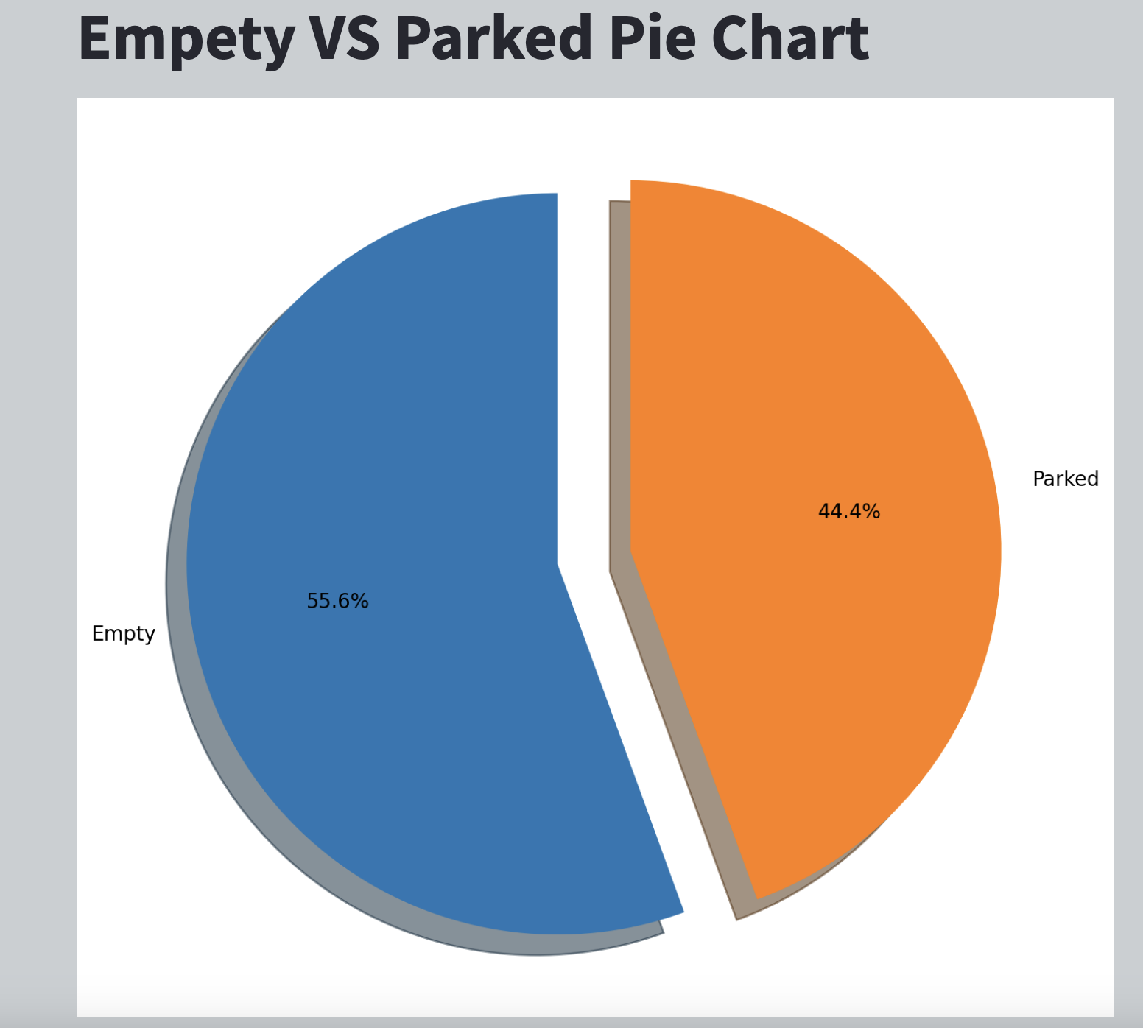
Experimental setups: Testing

Slide 15
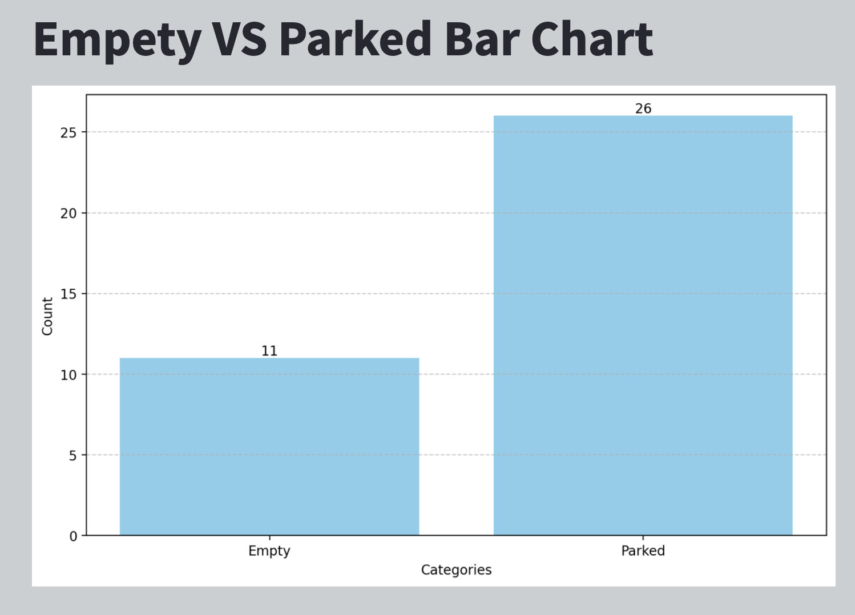
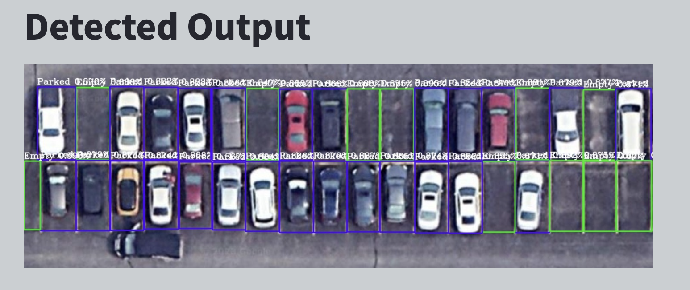
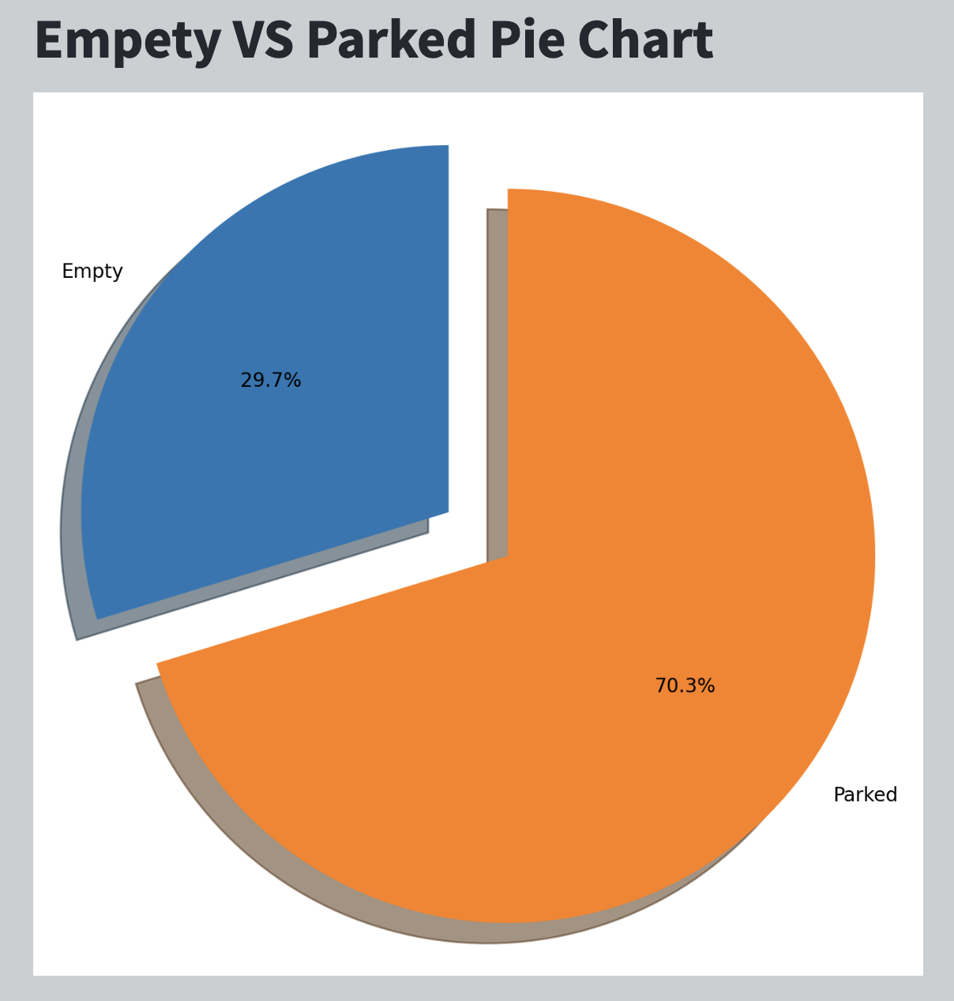
Experimental setups: Testing

Slide 16
Future Work
Testing in Real Environments: Our future plan includes moving beyond the testing phase with artificial data to conducting real-world tests in parking areas within Ames. This testing will allow us to assess the model’s performance under actual conditions and fine-tune it for real-world applications.
Diversifying the types of parking spaces, This includes the identification of non-standard parking zones, such as areas not designated for parking, and specially reserved spaces like disabled parking areas.

Slide 17
Conclusion
In conclusion, our project utilized the Yolo V8 algorithm and a custom parking dataset to develop a model that identifies parked and empty spaces in real-time with about 90% accuracy. Trained on Google Colab for 100 epochs, it processes visual inputs like images and videos, marking spaces with bounding boxes. Future improvements include using higher quality images from drones for better accuracy and expanding the model's recognition capabilities to include non-standard parking areas and disabled parking spaces. This project not only demonstrates our current achievements but also opens avenues for further advancements in automated parking solutions.

